Slide 1

Gym Management System
Saurav Rawat
Shivam Sinha

Slide 2
Introduction to Gym Management Systems
Importance
Benefits
Efficiency
Gym management systems play a crucial role in streamlining operations, enhancing member experience, and boosting business efficiency.
Using a gym management system leads to better organization, improved communication, and effective data management for gym administrators.
These systems automate tasks, simplify processes, and help in tracking progress and performance accurately.

Slide 3
Problem Statement In today's fast-paced world, managing a gym efficiently can be challenging due to the complexity of handling various aspects such as membership management, scheduling, billing, and tracking member progress.
Scheduling Issues:
Manual Record-Keeping:
Membership Management:
Many gyms still rely on paper-based systems or spreadsheets, leading to potential data entry errors, difficulty in retrieving information, and challenges in maintaining up-to-date records.
Handling membership details, renewals, and cancellations manually can be cumbersome. This often results in delays and difficulties in tracking membership status and generating reports.
Coordinating class schedules, trainer availability, and member bookings can be inefficient without a centralized system, leading to conflicts and mismanagement.

Slide 4
Solution Overview To address the challenges of managing a gym efficiently, the proposed Gym Management System (GMS) offers a comprehensive, integrated solution designed to streamline and automate various aspects of gym operations.
Integrated Scheduling
Efficient Billing and Payments
Automated Membership Management

Slide 5
Technology used
Java
Hibernate
DBMS
As Hibernate is a Java-based ORM tool, Java is a natural choice for building the backend of the gym management system.
Hibernate is an ORM tool that provides a layer of abstraction between the Java code and the underlying database. It can be used to interact with the database, perform CRUD (Create, Read, Update, Delete) operations, and map Java objects to database tables.
A RDBMS such as MySQL, PostgreSQL, or Oracle can be used to store the data for the gym management system. Hibernate can be used to interact with the RDBMS and perform CRUD operations.

Slide 6
Architecture/Design
Member
Database
Person
Register
Trainer
Admin
Fetch data from database
Show Dashboard
Person
Login as
Trainer
Member

Slide 7
Advantages of Implementing a Gym Management System
Efficiency
Member Engagement
Revenue Management
Implementing a gym management system leads to improved operational efficiency, saving time and effort in administrative tasks.
These systems enhance member experience through personalized interactions, goal tracking, and tailored workout plans.
Gym management systems help in optimizing revenue streams, tracking financials, and managing memberships effectively.

Slide 8
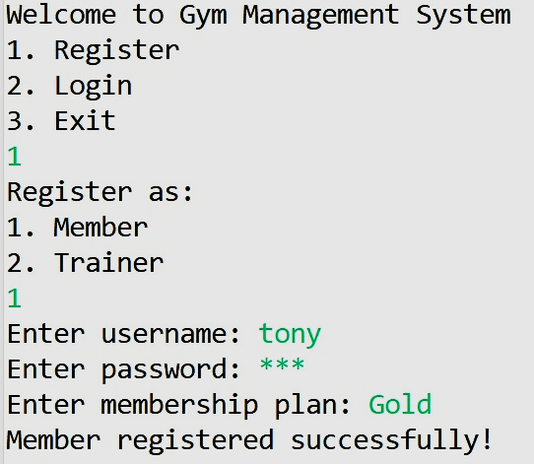
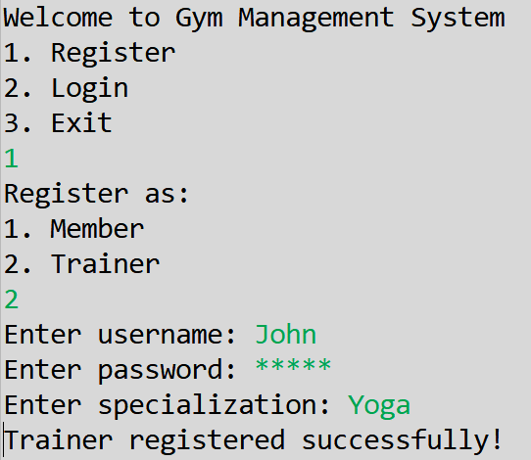
Output
Register as Member
Register as Trainer

Slide 9
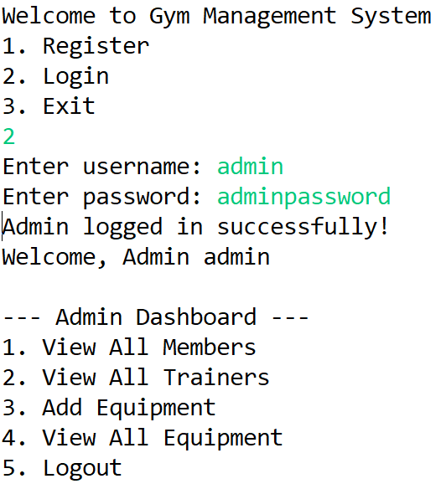
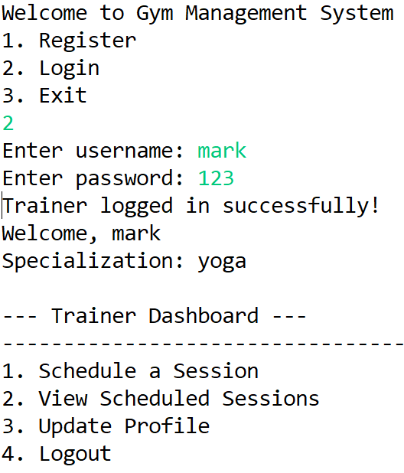
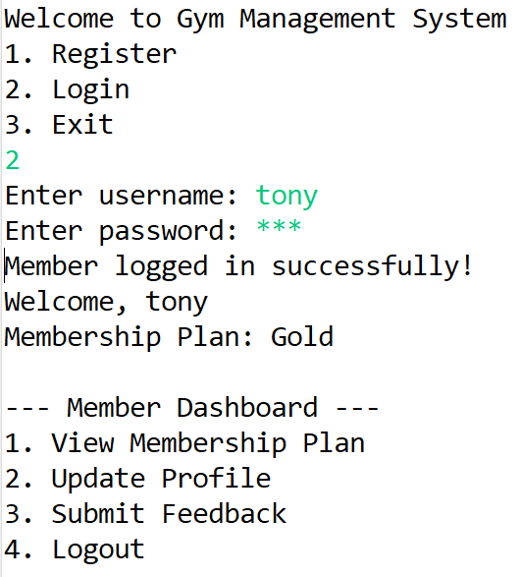
Output
Login as Admin
Login as Trainer
Login as Member
************
*******

Slide 10
Future Scope
Billing and Payments:
Progress Tracking:
Processing payments, managing invoices, and tracking financial transactions manually can be error-prone and time-consuming, affecting financial accuracy and efficiency.
Without a robust system, tracking member progress, setting goals, and providing personalized feedback can be challenging, impacting member satisfaction and retention.

Slide 11
Thank you

